Slide 1

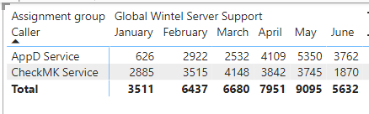
Wintel – Monitoring Review
Wintel’s monitoring noise stems from two automated alerts from CheckMK and Appd.
What is the Problem?
Lack of needed fine tuning with the monitoring tools has led to an increased amount of non-actionable noise that negatively impacts teams’ ability to respond to alerts.

Slide 2
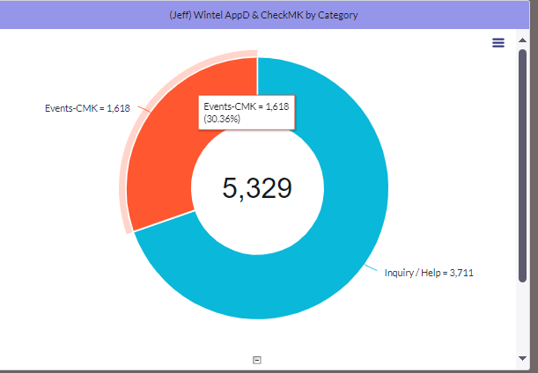
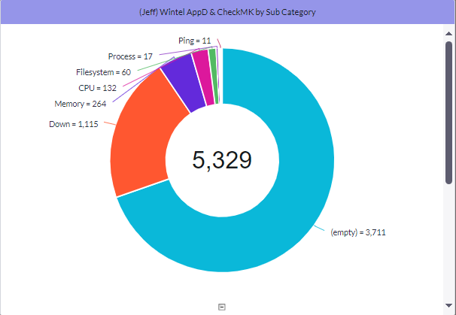
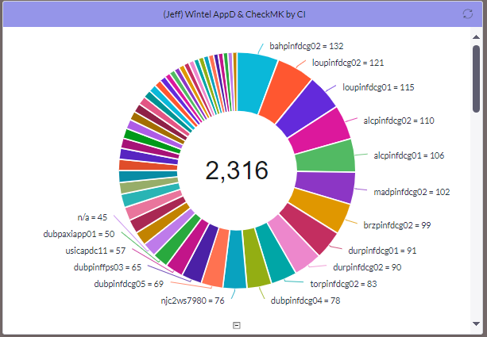
Wintel – Monitoring Review
Approach: Identify the top Talkers: The following action has been applied
Setup a dashboard that will address top talker identification
Peruse tickets to have consistent categorization for better noise identification
Schedule weekly ticket noise analysis
Create action plans on identified noise and execute them.

Slide 3
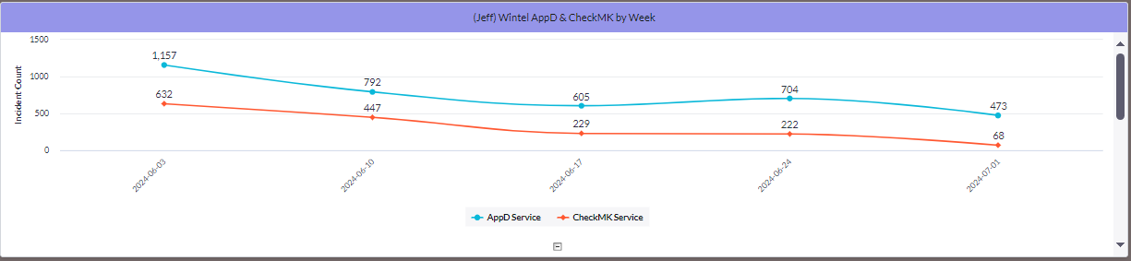
Wintel – Monitoring Review
How Are We Progressing?
There are multiple workflows currently in flight based on noise identification:
Adjust server availability health threshold to reduce ticket generation
Identify application alerts that are driving noise (Active Directory Monitoring)
Fine Tune checkmk Alerts to eliminate non-actionable alerts
Established a process to turn off checkmk/alerting alerting during patching and site-wide activity

Slide 4
Wintel – Monitoring Review
Current Progress:
As we continue to fine-tune availability alerts, we target a reduction of 70% of alerts received. This can be achieved by :
Weekly ticket volume trend.
Ticket Quality checks focusing on engineers’ action to fix the source.
Continue to fine-tune checkmk
As we continue to transition to the new global checkmk instance, the volume of alerts will continue to fluctuate as we increase CI alerting coverage.

